Slide 1
Thank you for joining!
Slides and a recording of this webinar will be made available tomorrow: Presentations | National Core Indicators and Presentations | NCI-AD (National Core Indicators-Aging and Disabilities)
This meeting will be recorded
All participants are muted
Please type questions and comments into chat any time during the presentation

Slide 2


HOW TO RAISE HAND SLIDE
Unmute / Mute
your microphone.
Note: This meeting will be recorded.
2

Slide 3



Enhancing LTSS Quality Infrastructure using National Core Indicators® (NCI-IDD) and National Core Indicators—Aging and Disabilities™ (NCI-AD)
June 24, 2021

Slide 4
Agenda
1
A brief overview 25 years of National Core Indicators
2
How data are important to understanding quality
3
How to use NCI measures to support quality in your state
4
Using FMAP funding to support NCI implementation
5
State perspective
6
Questions
and comments

Slide 5



25 years of National Core Indicators
A brief overview of NCI-IDD and NCI-AD

Slide 6


National Core Indicators®
National Core Indicators– Aging and Disabilities
Established: 1997
Participating states: soon to be 48 and D.C.
Population addressed: Individuals with intellectual/developmental disabilities (IDD)
nationalcoreindicators.org
Established: 2015
Participating states: 22
Population addressed: Older adults and people with physical disabilities
nci-ad.org

Slide 7
National Core Indicators Purpose
Hear directly from people receiving services about their experiences and lives
(Person-Reported Outcomes)
Report state and national benchmarks of system-level performance. Allow states to compare to other states and to the NCI Average.
Establish validated sets of performance and outcome indicators for LTSS systems that align with stakeholder priorities.

Slide 8
NCI-IDD Data
Designed by states for states to reflect current data needs, the latest research and policy landscape
Over 20-year history of collecting information about outcomes for people who use state IDD service delivery systems and their families
Surveys are tested and measures are validated. Rigorous NCI revision cycle/process to ensure survey content aligns with stakeholder priorities
Survey Tools
Family Surveys
Staff Stability
In-Person Survey

Slide 9
NCI-IDD Outcomes Domains
Individual Outcomes
Community Inclusion and participation
Health, Wellness and Rights
Choice & Decision making
Relationships
Safety
Service Coordination
Employment
Satisfaction
System Performance
Health
Medications
Respect and Rights
Self-Direction
Access
Service Coordination
Workforce

Slide 10

In-Person Survey (IPS)
People who receive at least one service in addition to case management from the IDD agency
Direct survey with the person receiving services
  Historically in-person surveys
  Introduced video conference surveying in 2020-21
Survey includes three main parts:
  Background information – largely collected from state records
  Section I – Subjective questions only the person can answer
  Section II – Objective questions can be answered by a proxy when needed
Section I and Section II together take 50 minutes (on average)

Slide 11
Family Experience Domain
Choice and Decision-making
Family Involvement
Information & Planning
Access and Support Delivery
Community Connections
Health, Welfare and Safety
Family Satisfaction

Slide 12

Family Surveys
Examines how well public systems support family members and guardians in delivery of services and level of satisfaction with service delivery. Designed to gauge the family experience.
  The Adult Family Survey (AFS)
    Respondents are families living with an adult family member (age 18 and over) receiving DD services.
  The Family/Guardian Survey (FGS)
    Respondents are families/guardians with an adult family member (age 18 and over) receiving DD services with whom they do NOT live.
  The Child Family Survey (CFS)
    Respondents are families living with child (not yet receiving adult services) receiving DD services.

Slide 13
Staff Stability
Staff Stability tool launch 2014
Currently in use by 26 state
Data come directly from providers HR records
Collects critical pieces of information on:
Turnover rate
Vacancy rates
DSP separations
Length of DSP employment (tenure)
Size of agency
Services provided
NCI Staff Stability Survey provides states with critical information on the stability and quality of the DSP workforce working with adults with IDD.

Slide 14
How states use Workforce data
NY
OH
PA
UT
TN
Uses Staff Stability data to compare outcomes before and after a DSP credentialing project.
Created innovation grants for providers which resulted in groundbreaking practices to retain DSPs
Is offering small grants to providers willing to try something new and share their learning.
Uses NCI data to advocate for, and assess outcomes of a wage increase
Used data as evidence to advocate for a rate increase. Then used NCI to determine whether rate increase went to wages.

Slide 15
NCI-AD Background
  Collaboration between ADvancing States, Human Services Research Institute (HSRI) and Participating States.
Grew out of NCI - Multiple areas of overlap for cross population comparison
Quality of life and outcomes survey that assesses the experiences of older adults and adults with physical disabilities served by state LTSS programs, including:
Nursing facilities | MLTSS populations
Medicaid waivers | State-funded programs
Medicaid state plans | Older Americans Act programs
PACE | Assisted living facilities

Slide 16
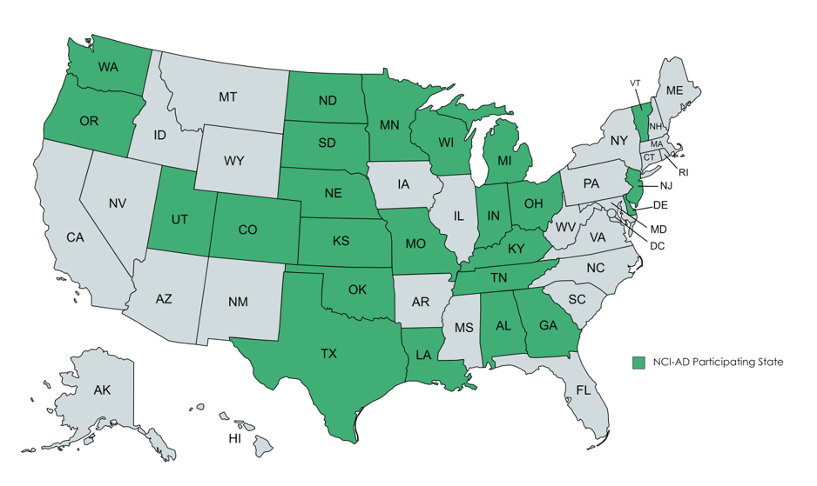
2021-22 NCI-AD State Participation

Slide 17
Adult Consumer Survey (ACS)
Direct survey with the person receiving services
Historically in-person surveys
Introduced video conference and telephone surveying in 2020-21
Survey includes three main parts:
Background information – largely collected from state records
Survey includes subjective and objective questions
Full survey takes approximately 45 minutes
Positive feedback from survey participants

Slide 18



New for 21-22: Additional Modalities
Pilot for 20-21 NCI-AD Year
Telephone and video conference modalities added for 21-22
New modalities are ADDITIVE to in-person modality – not in replacement of

Slide 19
2021-22 NCI-AD Domains
Community participation | Choice and control
Relationships | Satisfaction
Service coordination | Care coordination
Access to community | Access to needed equipment/modifications
Safety | Health care
Wellness | Medications
Rights and respect | Self-direction
Work | Everyday living
Affordability | Person-centered planning module (optional)
Access to technology | COVID supplement (optional)

Slide 20

How data are important to understanding quality
Using Quality Framework

Slide 21

Culture of Quality
Ceiling
Level 3– Drivers of Quality
Best views
Opportunity to improve
Opportunity to improve
Level 2– Outcome Measures
Basic QI process
Floor
Level 1– Performance Measures
Sub floor
Regional Office Program Audits
Formal Licensing Reviews; Incident Reporting
Foundation/ Sub Level: Compliance measures

Slide 22

Compliance with minimum standards punches your ticket to get in the game
Meeting these standards is the floor, not the ceiling
Go beyond for systemic improvement

Slide 23
Each Quality Strategy Requires Data
From the base to the top- all measures matter
Results
Outcome Measures
Process and Performance Measures
Health and Safety Measures
Medicaid Utilization Review (UR) and Program Integrity
Customer satisfaction, outcomes
Internal process improvement (Timeliness, accuracy and cost)
Med reports; Annual physical health exams; Incident management; Mortality reporting
Medicaid waiver PM’s

Slide 24


How to use NCI measures to support quality in your state

Slide 25
Supports for states implementing
NCI-IDD and NCI-AD
Assures reliability and validity of data collection through:
Technical assistance; Supporting state development of samples
Standardized implementation protocols, surveyor training and ongoing monitoring
Standardized reporting:
  National and state reports are publicly available online
  Multiple survey items align across surveys
Additional regularly-released publications provide data context and assist with communicating quality reporting results to stakeholders:
Data briefs
Spotlights

Slide 26
Supports for states implementing
NCI-IDD and NCI-AD
Goes beyond service satisfaction:
  Person-centered outcomes
  Impact of services on quality of life
State owns—and has immediate access to—its own data:
  States may add additional questions to target specific areas for improvement
  Administrative data allow for analysis of specific populations
Support communities of practice across states

Slide 27
What sets us apart?
Federal data collection
NCI-IDD
Medicaid Adult Core Set
NCI-AD
AARP Scorecard
Both programs
Likely inclusion into HCBS Recommended Measure Set
Medicaid & CHIP Scorecard

Slide 28
How are NCI data used?
Identify areas for service improvement
Communicate with service recipients, families, and advocates
Report to lawmakers and state legislature
Compare programs within the state and nationally
Track changes over time
HCBS Waiver Redesign/Development

Slide 29
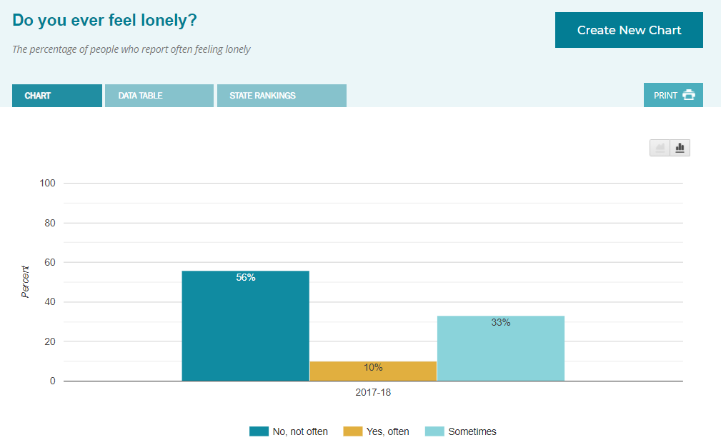
NCI Chart Generator

Slide 30


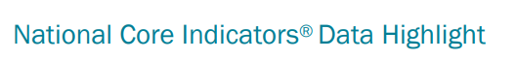


Additional Publications

Slide 31
State Perspective
Wisconsin

Slide 32
Using FMAP Funding

Slide 33
Permissible Uses of Enhanced FMAP For QI
Activity Function | Activity Description
Quality Improvement Activities | Upgrading critical incident management reporting systems Adopting new HCBS quality measures Implementing improvements to quality measurement, oversight, and improvement activities Implementing an experience of care survey
Taken from SMD# 21-003, Appendix D

Slide 34
Using FMAP for Quality Improvement with NCI
NCI-IDD and NCI-AD tools are validated as quality monitoring, experience of care tools
Use data collection to improve system performance
Evaluate HCBS compliance
Enhance ability to communicate data to stakeholders for improvement (e.g. communications processes for quality improvement – dashboards and beyond)
Increase sample population
Uncover disparities and target work towards health equity
Use outcomes to engage with stakeholders for diverse settings

Slide 35
BEST PRACTICES AND NEEDED DATA CAPACITY FOR HEALTH EQUTY DATA ANALYTICS: Unlocking the potential of state level data to uncover disparities and target work towards health equity.
Build and extend
Build and extend community of practice to support state level data analyses.
Enhance
Enhance demographic, race, ethnicity, geographic, and language data collection to allow for population - specific analyses.
Engage in
Engage in analyses to understand disparities in access to services, and eligibility processes, which may bias available data.
Extend
Extend outreach to communities to enhance data collection.

Slide 36
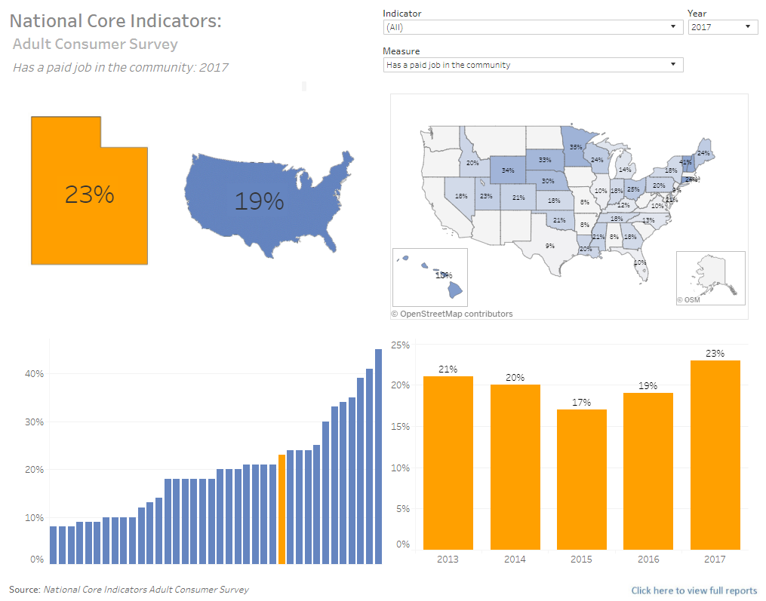
State dashboards
Several states created dashboards to:
Benchmark data
See results by area or region
Include other data sources
Link: https://dspd.utah.gov/dashboard/national-core-indicators/

Slide 37

EXAMINING AVAILABLE QUALITY OUTCOMES DATA BY RACE AND ETHNICITY
  NCI-IDD and NCI-AD as a source to examine experiences and move towards equity
    NCI Data Brief: Racial Equity (nationalcoreindicators.org)
    Data Spotlight | NCI-AD (National Core Indicators-Aging and Disabilities)
  Supporting states to use sampling approaches to ensure representative populations are reflected in quality assurance data

Slide 38

STRATEGY: ENGAGING WITH COMMUNITIES IN BOTH DATA COLLECTION AND DATA USE
  Plain language versions (multiple language)
  Data "road shows"
  Community Data Walks
https://www.urban.org/sites/default/files/publication/72906/2000510-Data-Walks-An-Innovative-Way-to-Share-Data-with-Communities.pdf

Slide 39

Questions?
Comments?

